Slide 1

Chapter 33 Containers, Layout Managers, and Borders

Slide 2
Objectives
To explore the internal structures of the Swing container (§33.2).
To explain how a layout manager works in Java (§33.3).
To use CardLayout and BoxLayout (§§33.3.1-33.3.2).
To to use the absolute layout manager to place components in the fixed position (§33.3.3).
To create custom layout managers (§33.4).
To use JScrollPane to create scroll panes (§33.5).
To use JTabbedPane to create tabbed panes (§33.6).
To use JSplitPane to create split panes (§33.7).
To use various borders for Swing components (§33.8).

Slide 3
How a Component is Displayed?
User interface components like JButton cannot be displayed without being placed in a container. A container is a component that is capable of containing other components. You do not display a user interface component; you place it in a container, and the container displays the components it contains.
The base class for all containers is java.awt.Container, which is a subclass of java.awt.Component. The Container class has the following essential functions:

Slide 4
What Does a Container Do?
The base class for all containers is java.awt.Container, which is a subclass of java.awt.Component. The Container class has the following essential functions:
It adds and removes components using various add and remove methods.
It maintains a layout property for specifying a layout manager that is used to lay out components in the container. Every container has a default layout manager.
It provides registration methods for the java.awt.event.ContainerEvent .

Slide 5
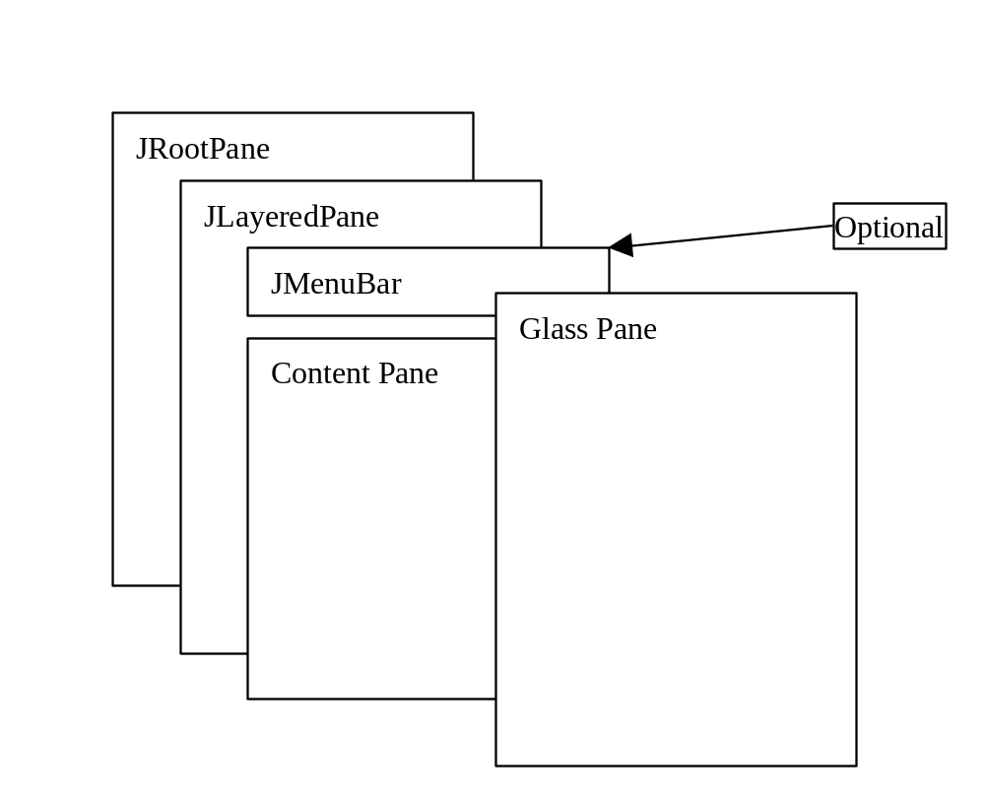
Structures of the Swing Containers
A lightweight container used behind the scenes by Swing's top-level containers, such as JFrame, JApplet, and JDialog
The glass pane floats on top of everything. It is a hidden pane by default.
A container that manages the optional menu bar and the content pane
The content pane is an instance of Container. By default, it is a JPanel with BorderLayout. This is the container where the user interface components are added.

Slide 6
JFrame
JFrame, a Swing version of Frame, is a top-level container for Java graphics applications. Like Frame, JFrame is displayed as a standalone window with a title bar and a border. The following properties are often useful in JFrame.
  contentPane
  iconImage
  jMenuBar
  layout
  title
  resizable

Slide 7
JApplet
JApplet is a Swing version of Applet. Since it is a subclass of Applet, it has all the functions required by the Web browser. Here are the four essential methods defined in Applet:
  contentPane
  jMenuBar
  layout

Slide 8
JPanel
Panels act as sub-containers for grouping user interface components. javax.swing.JPanel is different from JFrame and JApplet. First, JPanel is not a top-level container; it must be placed inside another container, and it can be placed inside another JPanel. Second, since JPanel is a subclass of JComponent, it is a lightweight component, but JFrame and JApplet are heavyweight components.

Slide 9
About Layout Managers
Each container has a layout manager, which is responsible for arranging the components in a container.
The container's setLayout method can be used to set a layout manager.
Certain types of containers have default layout managers.
The layout manager places the components according to the layout manager's rules, property settings and the constraints associated with each component.
Each layout manager has a particular set of rules specific to that layout manager.

Slide 10
The Size of Components in a Container
The size of a component in a container is determined by many factors, such as:
The type of layout manager used by the container.
The layout constraints associated with each component
The size of the container.
Certain properties common to all components (such as preferredSize, minimumSize, maximumSize, alignmentX, and alignmentY).

Slide 11
preferredSize, minimumSize, and maximumSize
The preferredSize property indicates the ideal size at which the component looks best. Depending on the rules of the particular layout manager, this property may or may not be considered. For example, the preferred size of a component is used in a container with a FlowLayout manager, but ignored if it is placed in a container with a GridLayout manager.
The minimumSize property specifies the minimum size at which the component is useful. For most GUI components, minimumSize is the same as preferredSize. Layout managers generally respect minimumSize more than preferredSize.
The maximumSize property specifies the maximum size needed by a component, so that the layout manager won't wastefully give space to a component that does not need it. For instance, BorderLayout limits the center component's size to its maximum size, and gives the space to edge components.

Slide 12
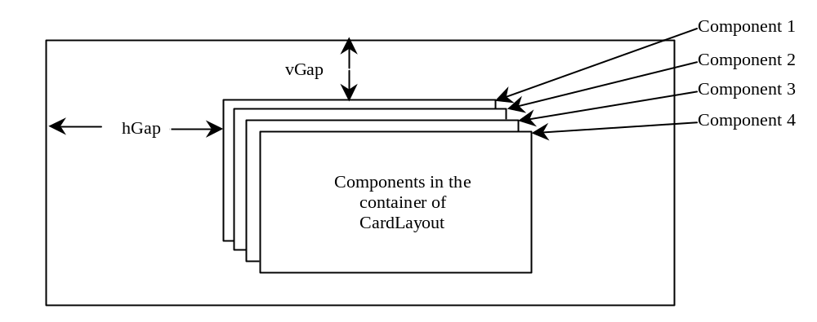
CardLayout
CardLayout places components in the container as cards. Only one card is visible at a time, and the container acts as a stack of cards. The ordering of cards is determined by the container's own internal ordering of its component objects. CardLayout defines a set of methods that allow an application to flip through the cards sequentially or to show a specified card directly.

Slide 13
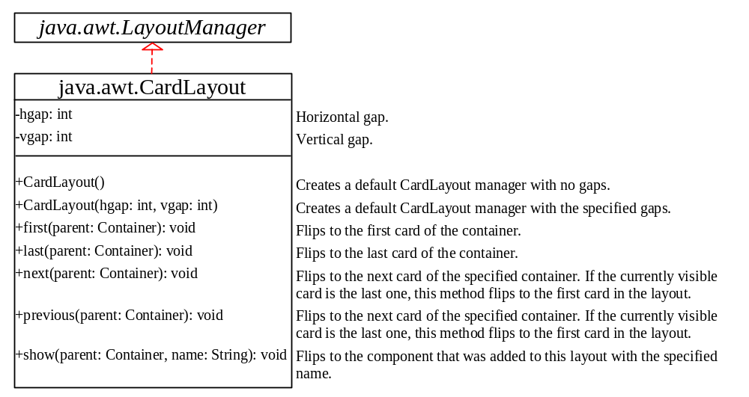
Using CardLayout
To add a component into a container, use the add(Component c, String name) method defined in the LayoutManager interface. The String parameter, name, gives an explicit identity to the component in the container.

Slide 14
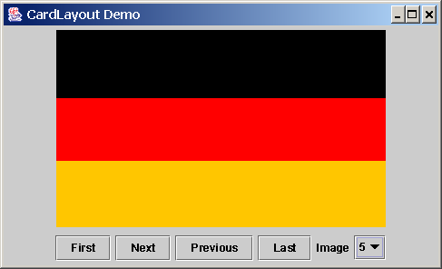
Example: Using CardLayout
Objective: Create two panels in a frame. The first panel holds named components. The second panel uses buttons and a choice box to control which component is shown.
ShowCardLayout
Run

Slide 15
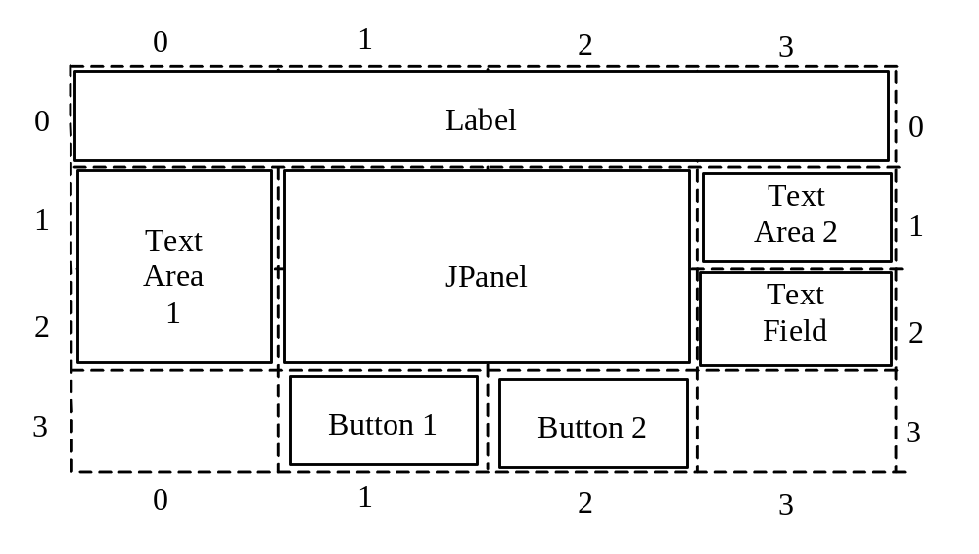
GridBagLayout
Companion Website
The GridBagLayout manager is the most flexible and the most complex. It is similar to the GridLayout manager in the sense that both layout managers arrange components in a grid. The components can vary in size, however, and can be added in any order in GridBagLayout.

Slide 16
GridBagConstraints
Companion Website
Each GridBagLayout uses a dynamic rectangular grid of cells, with each component occupying one or more cells called its display area. Each component managed by a GridBagLayout is associated with a GridBagConstraints instance that specifies how the component is laid out within its display area. How a GridBagLayout places a set of components depends on the GridBagConstraints and minimum size of each component, as well as the preferred size of the component's container.
To use GridBagLayout effectively, you must customize the GridBagConstraints of one or more of its components. You customize a GridBagConstraints object by setting one or more of its public instance variables. These variables specify the component location, size, growth factor, anchor, inset, filling, and padding.

Slide 17
GridBagConstraints Parameters
Companion Website
Location parameters: gridx and gridy
The variables gridx and gridy specify the cell at the upper left of the component's display area, where the upper-leftmost cell has the address gridx=0, gridy=0. Note that gridx specifies the column in which the component will be placed, and gridy specifies the row in which it will be placed. In Figure 33.5, Button 1 has a gridx value of 1 and a gridy value of 3, and Label has a gridx value of 0 and a gridy value of 0.

Slide 18
GridBagConstraints Parameters, cont.
Companion Website
Size parameters: gridwidth and gridheight
The variables gridwidth and gridheight specify the number of cells in a row (for gridheight) or column (for gridwidth) in the component's display area. The default value is 1. In Figure 33.5, the JPanel in the center occupies two columns and two rows, so its gridwidth is 2, and its gridheight is 2. Text Area 2 occupies one row and one column; therefore its gridwidth is 1, and its gridheight is 1.

Slide 19
GridBagConstraints Parameters, cont.
Companion Website
Growth parameters: weightx and weighty
The variables weightx and weighty specify the extra horizontal and vertical space to allocate for the component when the resulting layout is smaller horizontally than the area it needs to fill.
The GridBagLayout manager calculates the weight of a column to be the maximum weightx (weighty) of all the components in a column (row). The extra space is distributed to each column (row) in proportion to its weight.

Slide 20
GridBagConstraints Parameters, cont.
Companion Website
Anchor parameter:
The variable anchor specifies where in the area the component is placed when it does not fill the entire area. Valid values are:
  GridBagConstraints.CENTER (the default)
  GridBagConstraints.NORTH
  GridBagConstraints.NORTHEAST
  GridBagConstraints.EAST
  GridBagConstraints.SOUTHEAST
  GridBagConstraints.SOUTH
  GridBagConstraints.SOUTHWEST
  GridBagConstraints.WEST
  GridBagConstraints.NORTHWEST

Slide 21
GridBagConstraints Parameters, cont.
Companion Website
Filling parameter:
The variable anchor specifies where in the area the component is placed when it does not fill the entire area. Valid values are:
  GridBagConstraints.CENTER (the default)
  GridBagConstraints.NORTH
  GridBagConstraints.NORTHEAST
  GridBagConstraints.EAST
  GridBagConstraints.SOUTHEAST
  GridBagConstraints.SOUTH
  GridBagConstraints.SOUTHWEST
  GridBagConstraints.WEST
  GridBagConstraints.NORTHWEST

Slide 22
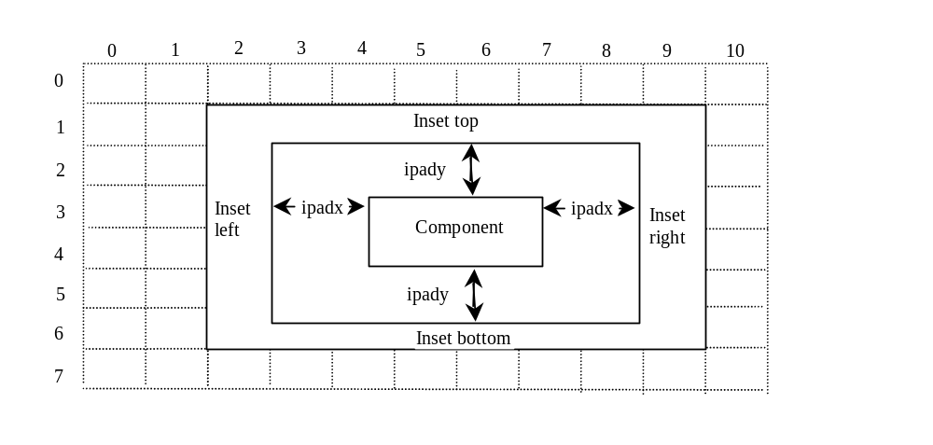
GridBagConstraints Parameters, cont.
Companion Website
Inset and padding parameters:

Slide 23
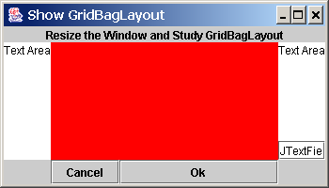
Example: Using GridBagLayout Manager
Companion Website
Objective: Write a program that uses the GridBagLayout manager to create a layout.
ShowGridBagLayout
Run

Slide 24
Using No Layout Manager
You can place components in a container without using any layout manager. In this case, you need to set layout for the container using
container.setLayout(null);
The components must be placed using the component’s instance method setBounds().
Tip: Do not use the no-layout-manager option to develop platform-independent applications.

Slide 25
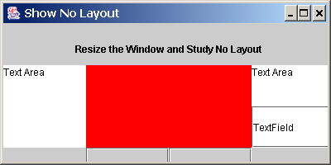
Example: Using No Layout Manager
This example shows a program that places the same components in the same layout as in the preceding example, but without using a layout manager.
ShowNoLayout
Run

Slide 26
BoxLayout
Flow layout arranges components in rows. javax.swing.BoxLayout is a Swing layout manager that arranges components in a row or a column. To create a BoxLayout, use the following constructor:
public BoxlayLayout(Container target, int axis)
This constructor is different from other layout constructors. The constructor creates a layout manager that is dedicated to the given target container. The axis parameter is BoxLayout.X_AXIS or BoxLayout.Y_AXIS, which specifies whether the components are laid out horizontally or vertically.

Slide 27
Creating a BoxLayout
For example the following code creates a horizontal BoxLayout for panel p1:
  JPanel p1 = new JPanel();
  BoxLayout boxLayout = new BoxLayout(p1, BoxLayout.X_AXIS);
  p1.setLayout(boxLayout);
You still need to invoke the setLayout method on p1 to set the layout manager.

Slide 28
The Box Class
You can use BoxLayout in any container, but it is simpler to use the Box class, which is a container of BoxLayout. To create a Box container, use one of the following two static methods:
  Box box1 = Box.createHorizontalBox();
      Box box2 = Box.createVerticalBox();
The former creates a box that contains components horizontally, and the latter creates a box that contains components vertically.
You can add components to a box in the same way that you add them to the containers of FlowLayout or GridLayout using the add method, as follows:
  box1.add(new JButton("A Button"));

Slide 29
Fillers in BoxLayout
A strut simply adds some space between components. The static method createHorizontalStrut(int) in the Box class is used to create a horizontal strut, and the static method createVerticalStrut(int) to create a vertical strut.
A rigid area is a two-dimensional space that can be created using the static method createRigidArea(dimension) in the Box class. For example, the following code adds a rigid area 10 pixels wide and 20 pixels high into a box.
  box2.add(Box.createRigidArea(new Dimension(10, 20));
A glue separates components as much as possible. For example, by adding a glue between two components in a horizontal box, you place one component at the left end and the other at the right end. A glue can be created using the Box.createGlue() method.

Slide 30
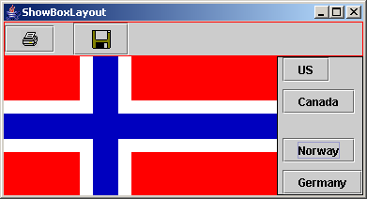
Example: Using BoxLayout Manager
Problem: Write a program that creates a horizontal box and a vertical box. The horizontal box holds two buttons with print and save icons. The horizontal box holds four buttons for selecting flags. When a button in the vertical box is clicked, a corresponding flag icon is displayed in the label centered in the applet.
ShowBoxLayout
Run

Slide 31
OverlayLayout
Companion Website
OverlayLayout is a Swing layout manager that arranges components on top of each other. To create an OverlayLayout, use the following constructor:
  public OverlayLayout(Container target)
The constructor creates a layout manager that is dedicated to the given target container. For example, the following code creates an OverlayLayout for panel p1:
  JPanel p1 = new JPanel();
  OverlayLayout overlayLayout = new OverlayLayout(p1);
  p1.setLayout(overlayLayout);
You still need to invoke the setLayout method on p1 to set the layout manager.

Slide 32
Order of Components in OverlayLayout Containers
Companion Website
A component is on top of the other if it is added to the container before the other one. Suppose components p1, p2 and p3 are added to a container of the OverlayLayout in this order, then p1 is on top of p2 and p2 is on top of p3.

Slide 33
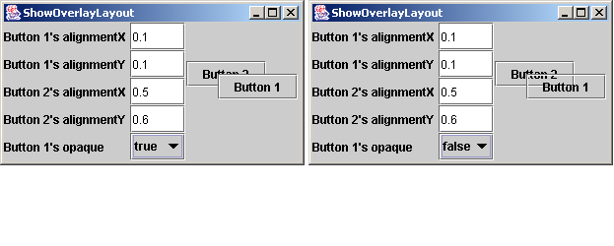
Example: Using OverlayLayout Manager
Companion Website
Problem: Write a program that overlays two buttons in a panel of OverlayLayout.
ShowOverlayLayout
Run

Slide 34
SpringLayout
Companion Website
SpringLayout is a new Swing layout manager introduced in JDK 1.4. The idea of SpringLayout is to put a flexible spring around a component. The spring may compress or expand to place the components in desired locations.
To create a SpringLayout, use its no-arg constructor:
  public SpringLayout()

Slide 35
The Spring Class
Companion Website
A spring is an instance of the Spring class, which can be created using one of the following two static methods:
· public static Spring constant(int pref)
  Returns a spring whose minimum, preferred, and maximum values each have the value pref.
· public static Spring constant(int min, int pref, int max)
  Returns a spring with the specified minimum, preferred, and maximum values.

Slide 36
Manipulating Springs
Companion Website
Each spring has a preferred value, minimum value, maximum value, and actual value. The getPreferredValue(), getMinimumValue(), getMaximumValue(), and getValue() methods retrieve these values. The setValue(int value) method can be used to set an actual value.
The Spring class defines the static sum(Spring s1, Spring s2) to produce a combined new spring, the static minus(Spring s) to produce a new spring running on the opposite direction, and the static max(Spring s1, Spring s2) to produce a new spring with larger values from s1 and s2.

Slide 37
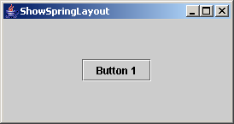
Example: Using SpringLayout Manager
Companion Website
Problem: Write a program that places a button in the center of the container.
ShowSpringLayout
Run

Slide 38
Creating Custom Layout Managers
In addition to the layout managers provided in Java, you can create your own layout managers. To do so, you need to understand how a layout manager lays out components. A container's setLayout method specifies a layout manager for the container. The layout manager is responsible for laying out the components and displaying them in a desired location with an appropriate size. Every layout manager must directly or indirectly implement the LayoutManager interface.
For instance, FlowLayout directly implements LayoutManager, and BorderLayout implements LayoutManager2, which implements LayoutManager. The LayoutManager interface provides the following methods for laying out components in a container:

Slide 39
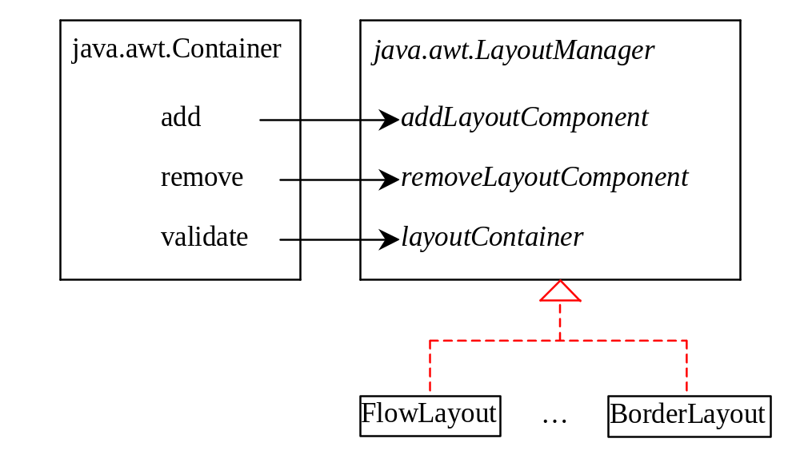
How Does a Container Interact with a Layout Manager
The add, remove, and validate methods in Container invoke the methods defined in the LayoutManager interface.

Slide 40
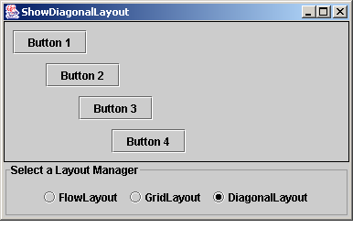
Example: Creating A Custom Layout Manager
Problem: This example creates a layout manager named DiagonalLayout that places the components in a diagonal. To test DiagonalLayout, the example creates an applet with radio buttons named “FlowLayout,” “GridLayout,” and “DiagonalLayout,” as shown in the figure. You can dynamically select one of these three layouts in the panel.
ShowDiagonalLayout
Run

Slide 41
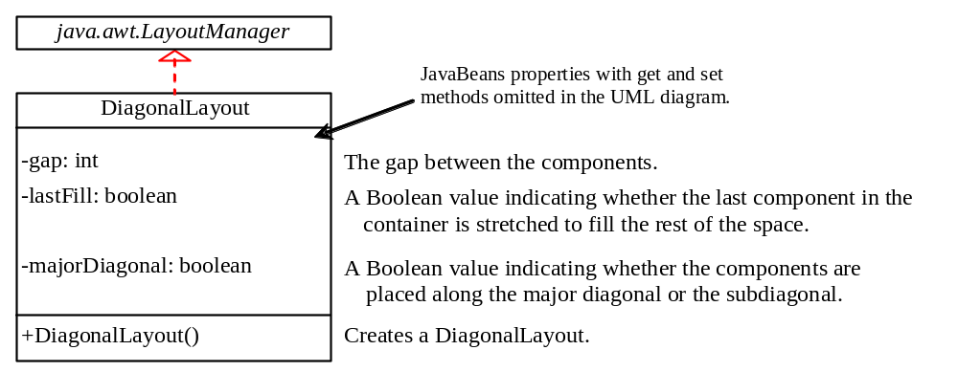
Custom DiagonalLayout Manager
DiagonalLayout

Slide 42
JScrollPane
Often you need to use a scrollbar to scroll the contents of an object that does not fit completely into the viewing area. JScrollBar and JSlider can be used for this purpose, but you have to manually write the code to implement scrolling with it. JScrollPane is a component that supports automatic scrolling without coding.
A scroll pane is a component that supports automatically scrolling without coding.

Slide 43
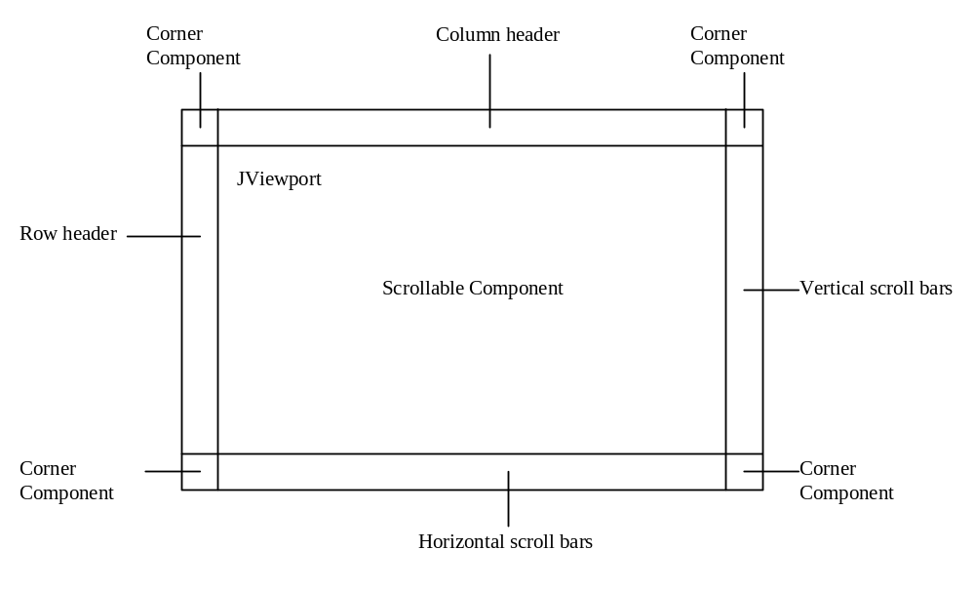
Scroll Pane Structures
A JScrollPane can be viewed as a specialized container with a view port for displaying the contained component. In addition to horizontal and vertical scrollbars, a JScrollPane can have a column header, a row header, and corners.

Slide 44
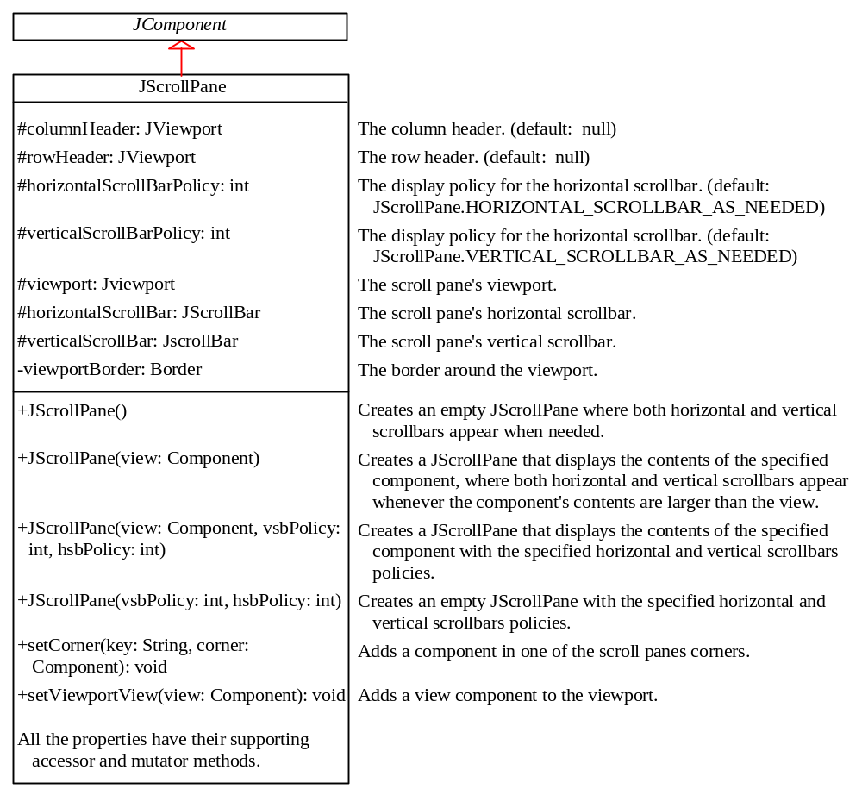
Using JScrollPane

Slide 45
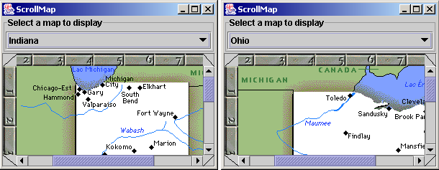
Example: Using Scroll Panes
Problem: This example uses a scroll pane to browse a large map. The program lets you choose a map from a combo box and display it in the scroll pane,
ScrollMap
Run

Slide 46
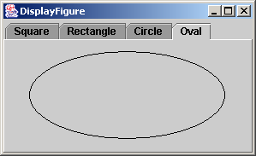
JTabbedPane
A tabbed pane provides a set of mutually exclusive tabs for accessing multiple components.

Slide 47
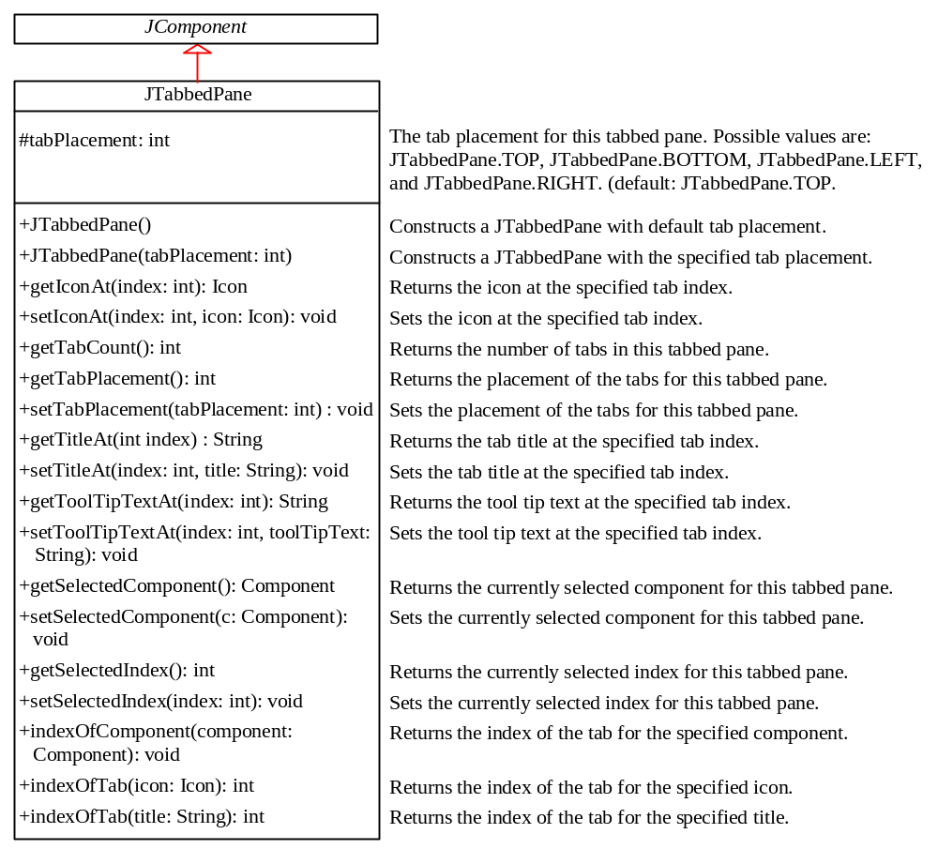
Using JTabbedPane
Usually you place the panels inside a JTabbedPane and associate a tab with each panel. JTabbedPane is easy to use, since the selection of the panel is handled automatically by clicking the corresponding tab. You can switch between a group of panels by clicking on a tab with a given title and/or icon.

Slide 48
Example: Using JTabbedPane
Problem: This example uses a tabbed pane with four tabs to display four types of figures: Square, Rectangle, Circle, and Oval. You can select a figure to display by clicking the corresponding tab.
DisplayFigure
Run

Slide 49
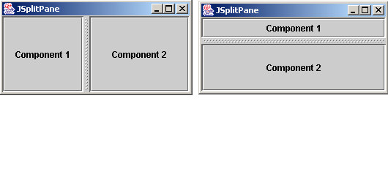
JSplitPane
JSplitPane is a convenient Swing container that contains two components with a separate bar known as a divider.

Slide 50
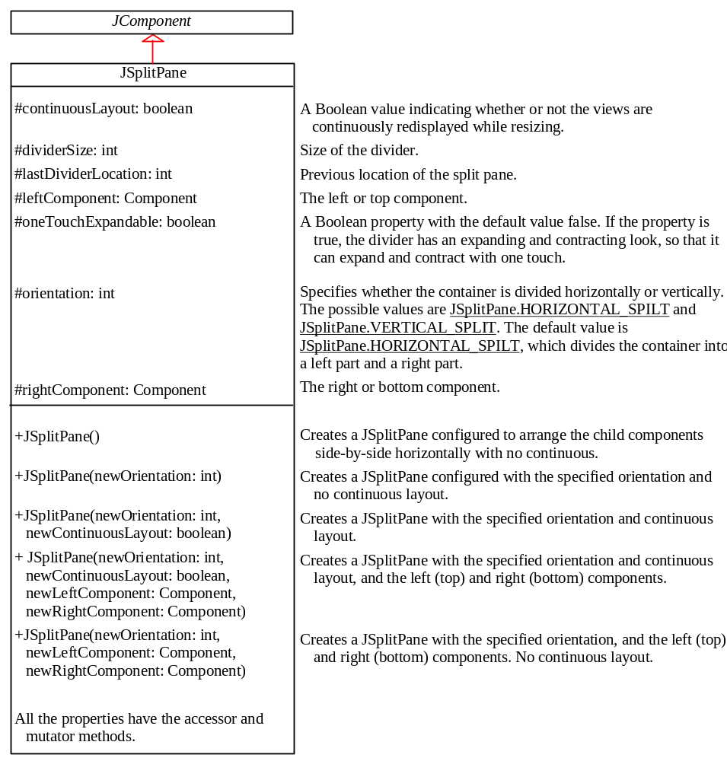
Using JSplitPane
The bar can divide the container horizontally or vertically, and can be dragged to change the amount of space occupied by each component.

Slide 51
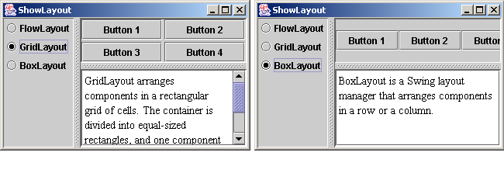
Example: Using JSplitPane
Problem: Write a program that uses radio buttons to let the user select a FlowLayout, GridLayout, or BoxLayout manager dynamically for a panel. The panel contains four buttons. The description of the currently selected layout manager is displayed in a text area. The radio buttons, buttons, and text area are placed in two split panes.
ShowLayout
Run

Slide 52
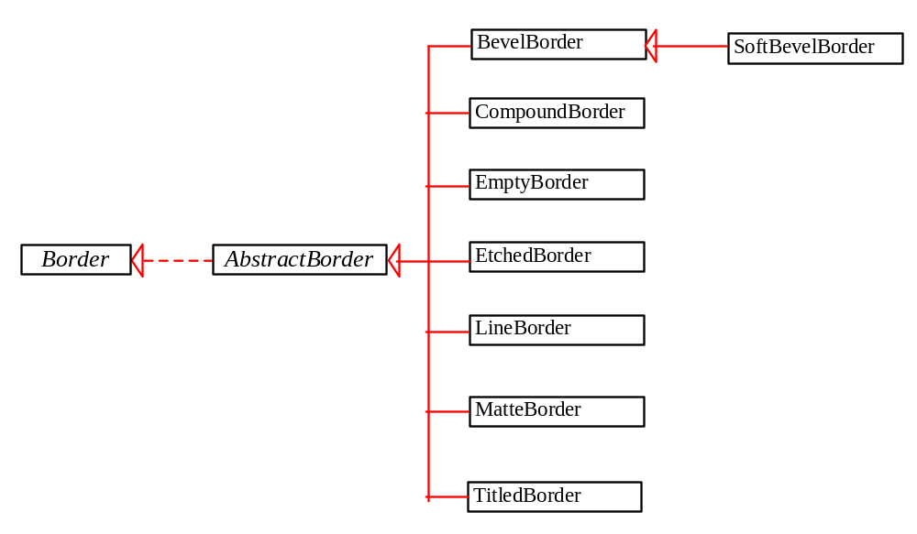
Swing Borders
A Swing border is defined in the Border interface. Every instance of JComponent can set a border through the border property defined in JComponent. If a border is present, it replaces the inset.
There are eight concrete border classes: BevelBorder, SoftBevelBorder, CompoundBorder, EmptyBorder, EtchedBorder, LineBorder, MatteBorder, and TitledBorder.
The AbstractBorder class implements an empty border with no size. This provides a convenient base class from which other border classes can be easily derived.

Slide 53
Static Method for Creating Borders
createTitledBorder(String title)
createLoweredBevelBorder()
createRaisedBevelBorder()
createLineBorder(Color color)
createLineBorder(Color color, int thickness)
createEtchedBorder()
createEtchedBorder(Color highlight, Color shadow, boolean selected)
createEmptyBorder()
createMatteBorder(int top, int left, int bottom, int right, Icon tileIcon)
createCompoundBorder(Border outsideBorder, Border insideBorder)

Slide 54
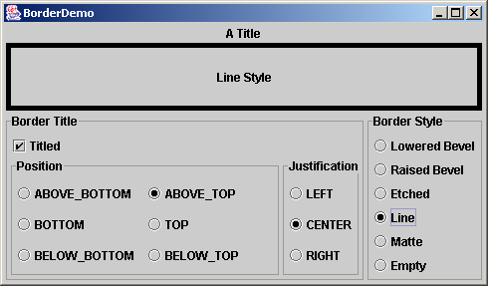
Example: Using Borders
Problem: This example gives a program that creates and displays various types of borders. You can select a border with a title or without a title. For a border without a title, you can choose a border style from Lowered Bevel, Raised Bevel, Etched, Line, Matte, or Empty. For a border with a title, you can specify the title position and justification. You can also embed another border into a titled border.
BorderDemo
Run

Slide 55



Pluggable Look-and-Feel
Companion Website
The pluggable look-and-feel feature lets you design a single set of GUI components that automatically has the look-and-feel of any OS platform. The implementation of this feature is independent of the underlying native GUI, yet it can imitate the native behavior of the native GUI.
Currently, Java supports the following three look-and-feel styles:
· Metal
· Motif
· Windows

Slide 56
Setting Look-And-Feel
Companion Website
The javax.swing.UIManager class manages the look-and-feel of the user interface. You can use one of the following three methods to set the look-and-feel for Metal, Motif, or Windows:
UIManager.setLookAndFeel
(UIManager.getCrossPlatformLookAndFeelClassName());
UIManager.setLookAndFeel
(new com.sun.java.swing.plaf.motif.MotifLookAndFeel());
UIManager.setLookAndFeel
(new com.sun.java.swing.plaf.windows.WindowsLookAndFeel());

Slide 57
Setting Look-And-Feel in
Static Initialization Block
Companion Website
To ensure that the setting takes effect, the setLookAndFeel method should be executed before any of the components are instantiated. Thus, you can put the code in a static block, as shown below:
static {
try {
// Set a look-and-feel, e.g.,
//UIManager.setLookAndFeel
// (UIManager.getCrossPlatformLookAndFeelClassName());
}
catch (UnsupportedLookAndFeelException ex) {}
}
Static initialization blocks are executed when the class is loaded.

